Slide 1
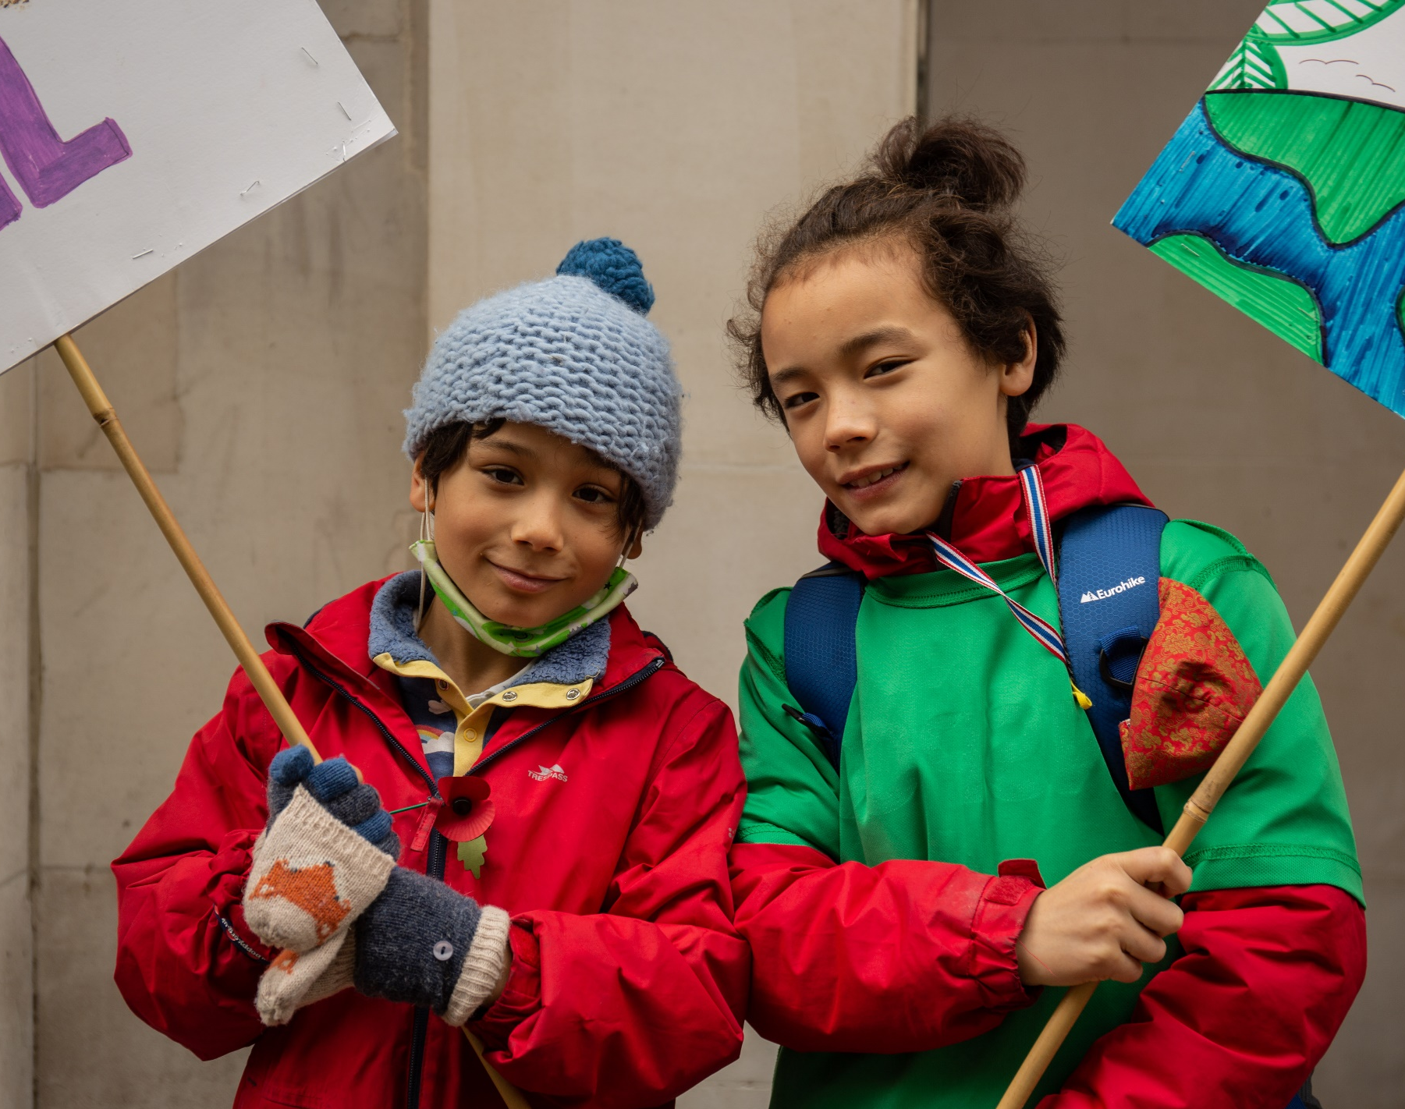
We gather
What will I do to help make a positive change to the world this Lent?
Blest are you Lord God of all creation (603, Laudate)
Notes:
Children’s liturgy –Third Sunday in Lent
Preparation of the worship space
Colour: purple
Song suggestions: Blest are you Lord God of all creation (603, Laudate); Morning has broken (671, Laudate)
Welcome: Today Jesus tells a story about a tree that did not bear any fruit and all the things that the gardener planned to try to make it grow better. People are like trees, they need certain things to grow and be healthy too. Let’s think a bit more about this today.

Slide 2
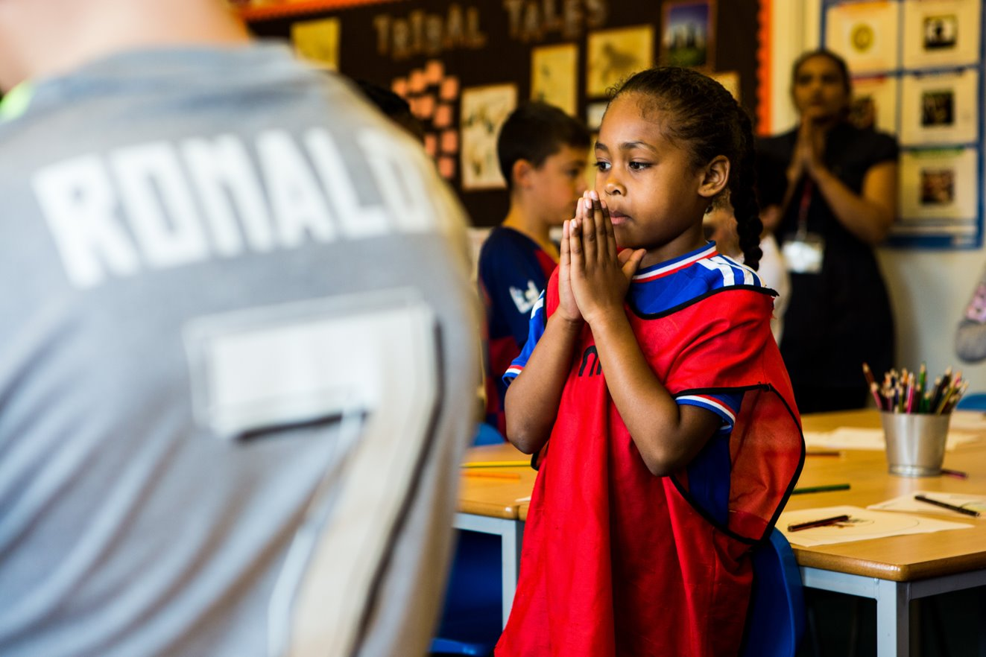
Forgiving God,
we thank you for the love and care that you show for us all.
Help us to grow in that love, and to do all that we can to help each other to live free from poverty and hunger. Amen.

Slide 3
Leave it alone, sir, just one more year; I will dig round it and put in some manure

Slide 4
Gospel: Luke 13:1-9
Jesus told this parable: “There was once a man who had a fig tree growing in his vineyard. He went looking for figs on it but found none. So, he said to his gardener, ‘Look, for three years I have been coming here looking for figs on this fig tree, and I haven't found any. Cut it down! Why should it go on using up the soil?’ But the gardener answered, ‘Leave it alone, sir, just one more year; I will dig round it and put in some manure. Then if the tree bears figs next year, so much the better; if not, then you can have it cut down.’”
We listen

Slide 5
What do you remember from the Gospel reading?
Jesus tells a parable. Do you know what a parable is?
The man who had planted the fig tree came out to pick some fruit, but there wasn’t any. How do you think the man felt? What did he decide to do? What did the gardener say?
What do you think the message of parable might be?
We respond

Slide 6
Jesus told a parable. A parable is a story which teaches us something. Jesus liked to use stories to explain things that were complicated.
The parable Jesus tells us today is about a fig tree.
Has anyone tasted figs? What are they like?
The man who had planted the fig tree had been waiting for three years for the tree to give him some fruit. He was angry and disappointed. He asked his gardener to cut down the tree.
The gardener asks for one more year to look after the tree – to dig round it and give it some manure to help it grow. Plants and trees need the right conditions to grow and the gardener hopes that by doing this, the tree will grow fruit.
Notes:
Photo of a fig tree by Johann Siemens on Unsplash

Slide 7
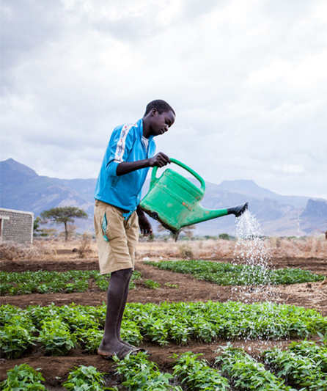
People need the right conditions to live their lives well too. Everyone needs enough food and water to stay healthy and strong. What else do we need to live?
How we treat other people can help them to grow and develop or stop them from doing so. We all have a responsibility to look after each other: our friends, our family and even people that we haven’t met around the world.
Even though there is enough food for everyone in the world, not everyone has enough to eat. Some of us don’t have clean running water. Some of us don’t have anywhere safe to live. Some of us don’t have the chance to go to school. Some of us are treated badly because of what we look like, where we come from or because we are disabled.

Slide 8
When the good things that God has given us are not shared fairly with everyone, those who do not have enough cannot grow and build a better future.
The fig tree in Jesus’ story is supposed to share its fruit with the man who planted it, but it is not doing what it is supposed to. Sometimes we are a bit like the fig tree. We do not share as well as we could.
So, if the fig tree in Jesus’ story is a bit like us, who do you think the gardener is?
The gardener is like Jesus. The gardener gives the fig tree another chance and gives it all the things it needs to live. Jesus is always ready to forgive us when we have done something wrong. And Jesus shows us how we should live our lives.
God gives us the chance to change, to share what we
have and to do all that we can to make sure that all
people have the things that they need to live.
How does it make you feel to know this?
Notes:
Photo by ripe figs by Tijana Drndarsk on Unsplash

Slide 9
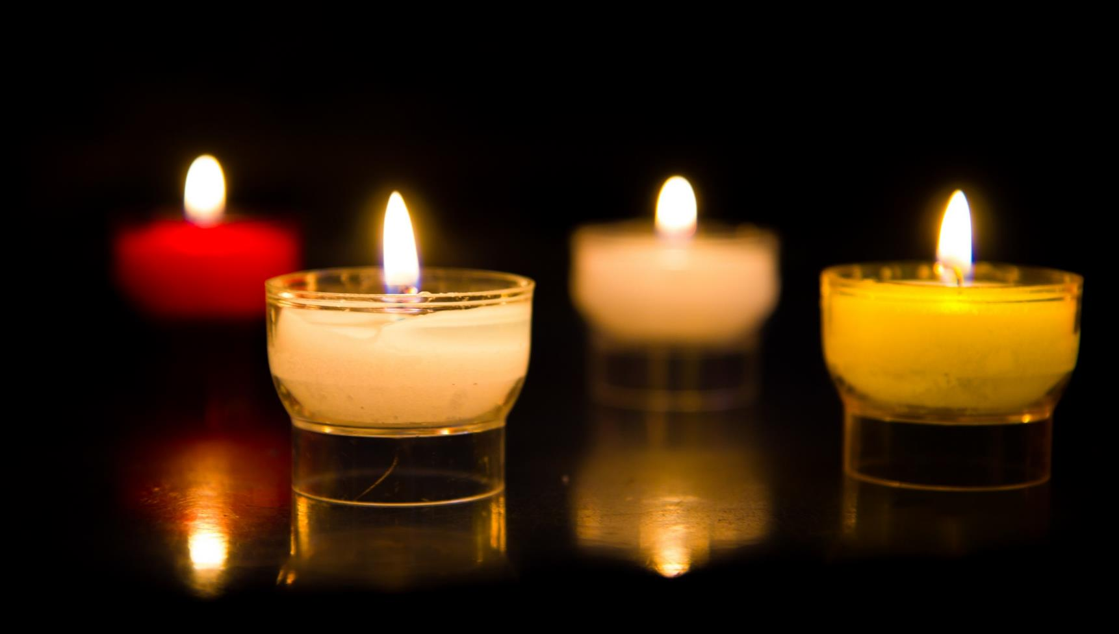
Let us pray…

Slide 10
We pray for world leaders: that they may make real changes so that we may all have enough food to eat. Lord, in your mercy…
We pray for all people throughout the world who are hungry: that together we may make a change so everyone has their fair share of God’s gifts. Lord, in your mercy…

Slide 11
We pray for our parish, our family and friends: that we may share what we have with others, and help make sure that all people have the chance to grow and live well. Lord, in your mercy…
Creator God,
you gave us a world full of wonderful things. May we share these fairly with each other, so all people have the chance to grow and live happy lives.
Amen.

Slide 12
What will I do to help make a change to our world and the way food systems work so that everyone has their fair share of food?
Going forth

