Slide 1
The Good News of Jesus

Slide 2
Today we hear Jesus telling people what it is he has come to do. One of the things he says is that he has come to bring good news to people who are poor. Our faith calls us to do the same. Let’s think a bit more about what this good news is and how we can share it with others today.
In the Name of the Father…
Loving God, you sent your Son Jesus to share the good news of your love for everyone. May we also share this good news through our words and all that we do. Amen.

Slide 3
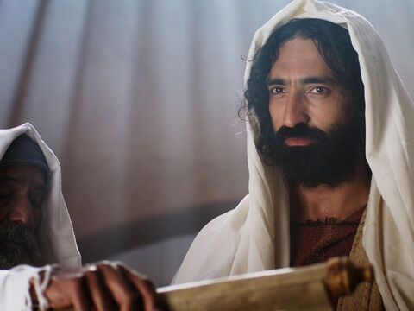
The Gospel according to Luke
Then Jesus returned to Galilee, and the power of the Holy Spirit was with him. The news about him spread throughout all that territory. He taught in the synagogues and was praised by everyone.
Then Jesus went to Nazareth, where he had been brought up, and on the Sabbath he went as usual to the synagogue. He stood up to read the Scriptures and was handed the book of the prophet Isaiah. He unrolled the scroll and found the place where it is written,
“The Spirit of the Lord is upon me, because he has chosen me to bring good news to the poor. He has sent me to proclaim liberty to the captives and recovery of sight to the blind, to set free the oppressed and announce that the time has come when the Lord will save his people.”
Jesus rolled up the scroll, gave it back to the attendant, and sat down. All the people in the synagogue had their eyes fixed on him, as he said to them, “This passage of scripture has come true today, as you heard it being read.”

Slide 4
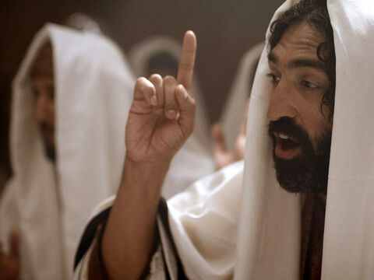
Let’s Reflect…
Jesus is teaching in the synagogue. He reads a passage from the Scriptures which is about himself (although the people listening don’t know that until he explains it afterwards).
The Scripture passage talks about what Jesus has been sent to do. It says that he has come to bring good news to people who are poor. I wonder what this means.
I wonder if you remember a time when you heard some good news. What was it? How did you feel?

Slide 5
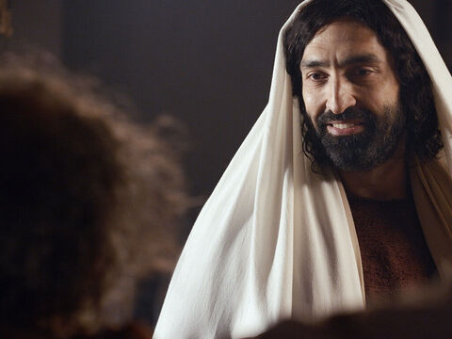
Good news means different things to different people. It can be confidence, peace, enough food, light in the darkness, doing well at school, getting to spend the day with friends.
We are all God’s children. God loves us all. No matter where in the world we are, whether we are rich or poor, and we should all have the chance to live in a world of peace, dignity and fairness. This is the good news of Jesus.
How do you think we can try to share this good news with our brothers and sisters around the world today?

Slide 6
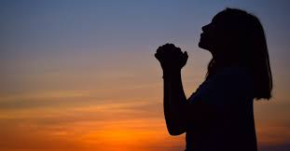
Prayers
Let us offer our prayers to God, who loves us and listens to us:
We pray for the Church throughout the world: that we may follow the example of Jesus, bring good news to people who are poor and working to help all people live life to the full. Lord, in your mercy…
We pray for people who are poor: that they may have their chance to share their good news stories and to build a better future. Lord, in your mercy…
We pray for our parish, families and friends: that we may always do our best to help others, to share what we have and to share the good news with people who are poor. Lord, in your mercy…
Closing prayer: God of life, you call us all to share your good news. May we do all that we can to answer that call. We ask this through Christ our Lord, Amen.

