Slide 2
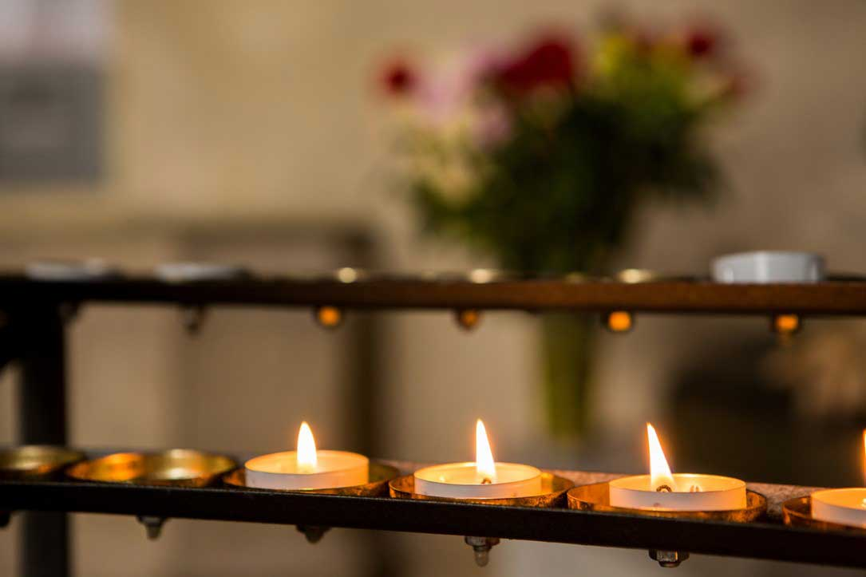
The light of Christ has come into the world!

Slide 3
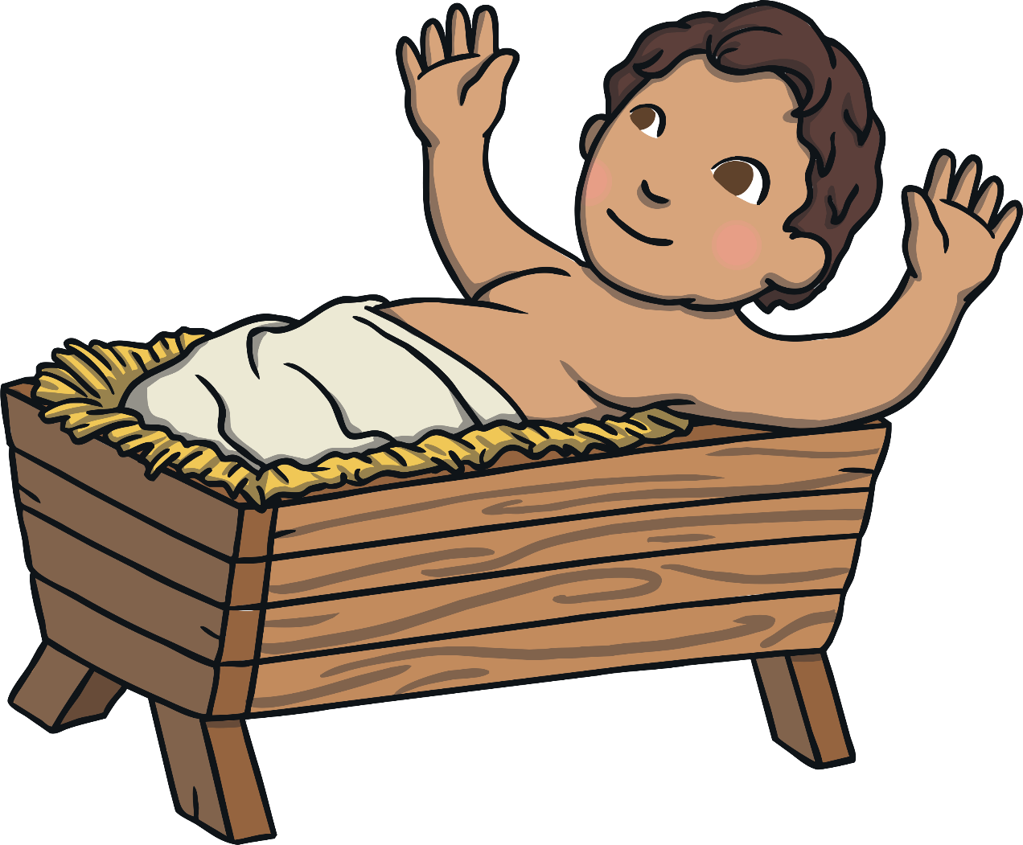
The Meaning
The word ‘epiphany’ comes from the verb ‘to appear’.
The feast of Epiphany is celebrating the Baby Jesus being seen or appearing, to the visitors who had travelled to see him.

Slide 4
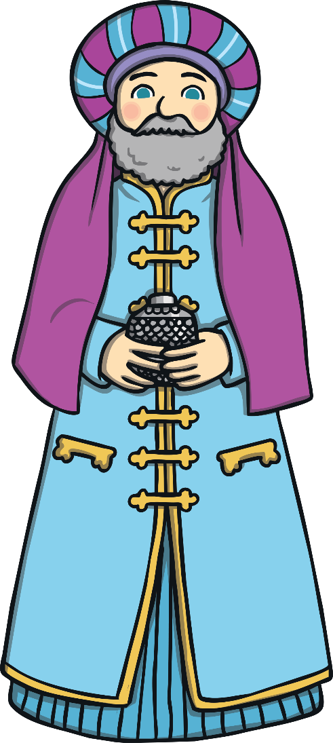
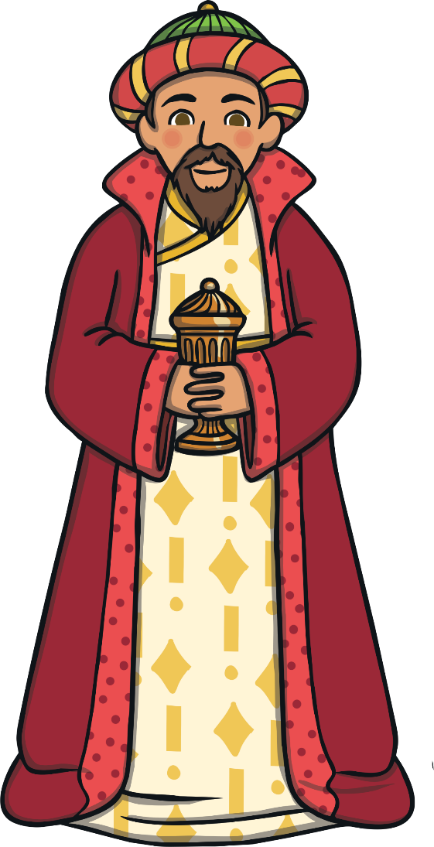
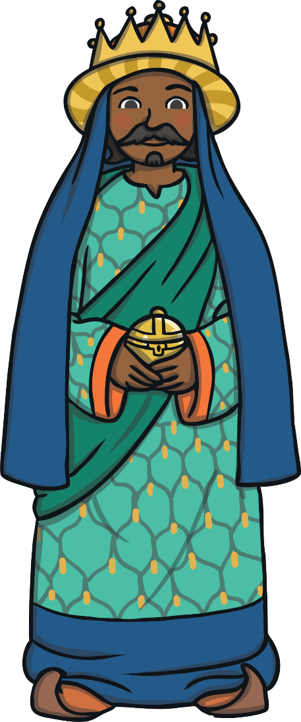
The Visitors
So, who were these visitors?
A long, long way away, there were some wise men studying the stars with their telescopes.
One night, they saw a very interesting star. Very interesting indeed!
These men lived in the east, and were possibly from Persia, which is now called Iran.

Slide 5
The Star
The Wise Men were very clever, and understood the religious writings that had been written many years before.
The writings told them that one day there would be a great star and the star would mean that a new king had been born.
So, the men decided to pack up their belongings, and follow the star to wherever it led them.

Slide 6
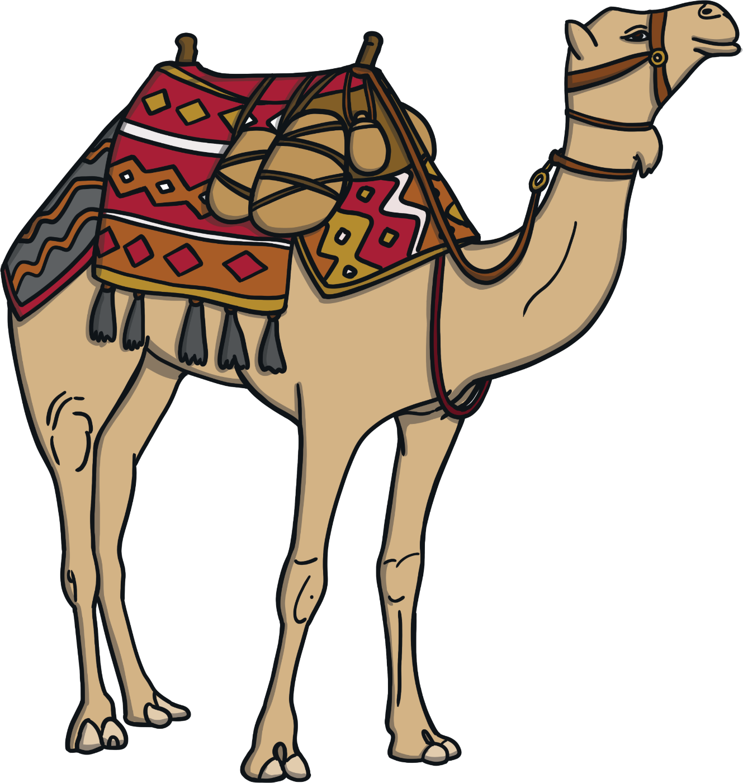
The Journey
The journey would have been very long.
They probably travelled on camels, across deserts and over mountains.
The star led them to the town of Bethlehem in Israel.

Slide 7
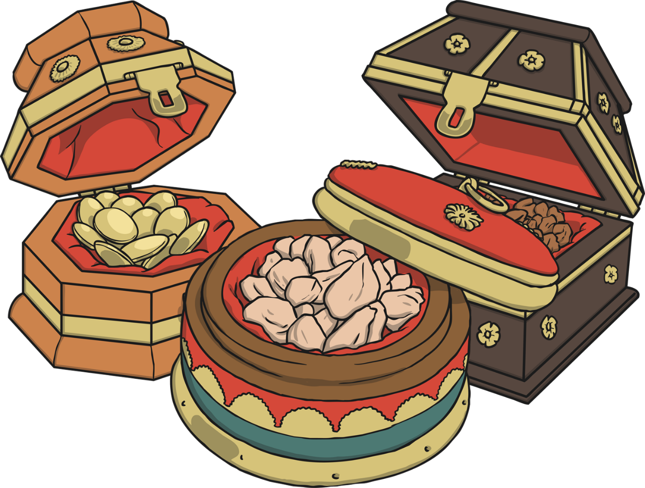
The Gifts
The star came to rest over the place where Jesus was, and the Wise Men brought expensive gifts for him and worshipped the new king.
The Bible never mentions how many wise men there were, but because there were three gifts, people often think there must have been three wise men.
Did you know?
The Wise Men are sometimes called the Three Kings because of the expensive gifts they brought.
The gifts were gold, frankincense and myrrh.

Slide 8
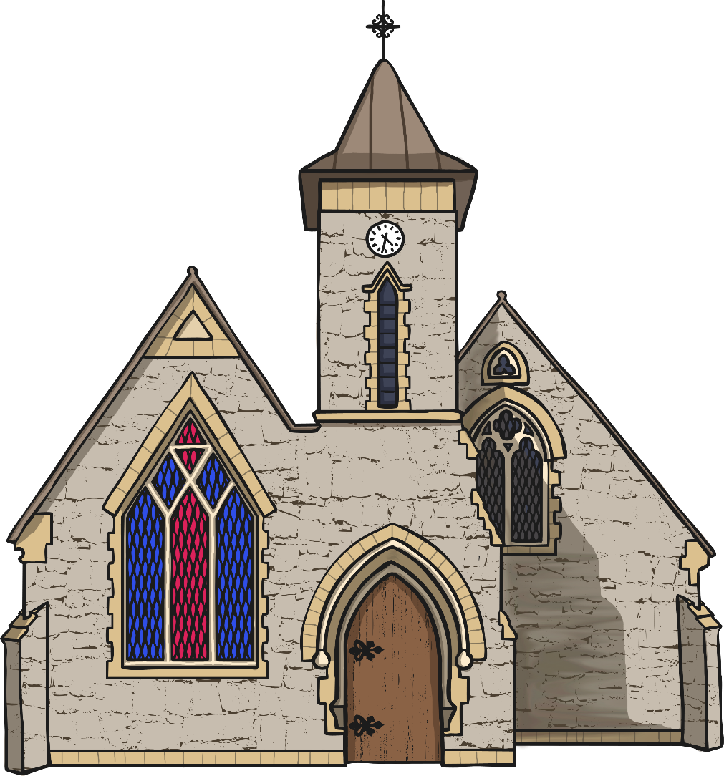
The Feast of Epiphany
The Feast of Epiphany is celebrated in churches, usually on the 6th January.
Epiphany is also known as Three Kings’ Day.

Slide 9
In the gospel of Mark, we hear the story of how some wise men from another part of the world were led by a star and travelled the long journey to Bethlehem, looking for Jesus.

Slide 10
A reading from the Gospel of Mark:
“After Jesus had been born at Bethlehem in Judaea during the reign of King Herod, some wise men came to Jerusalem from the east... And suddenly the star they had seen rising went forward and halted over the place where the child was. The sight of the star filled them with delight and going into the house they saw the child with his mother Mary and falling to their knees they did him homage. Then, opening their treasures, they offered him gifts of gold, frankincense and myrrh.”
The Gospel of the Lord
All: Praise to you Lord Jesus Christ.

Slide 11
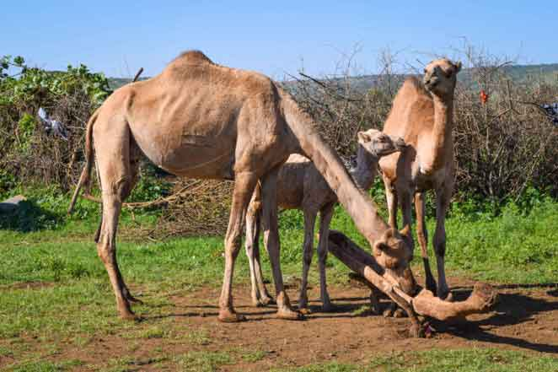
The Son of God, Jesus, came into the world, to give life to every member of the human race. No matter what our race, nationality, colour or religion, each of us is made in the image and likeness of God. For all of us, this is a day of real celebration – we, too, are chosen.

Slide 12
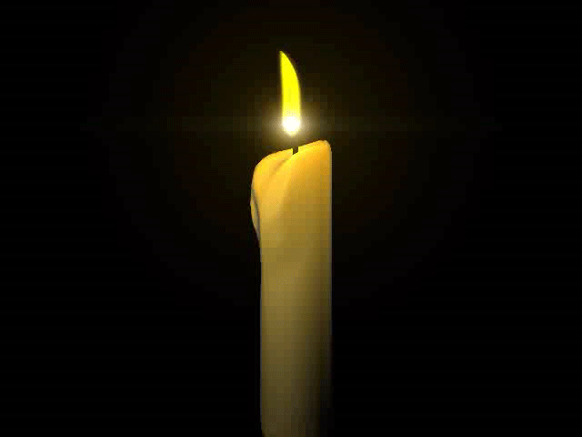
Let’s Reflect
I wonder how would you have feel seeing Jesus
I wonder why you think this day is important.

Slide 13
Let us pray…
Lord God of heaven and earth, You revealed your Son to every nation by the light of a star. Bless our school/classroom And all who study and work here and those who visit us. Fill us with the light of Christ that our love for one another reflects your love for all peoples.

