Slide 2
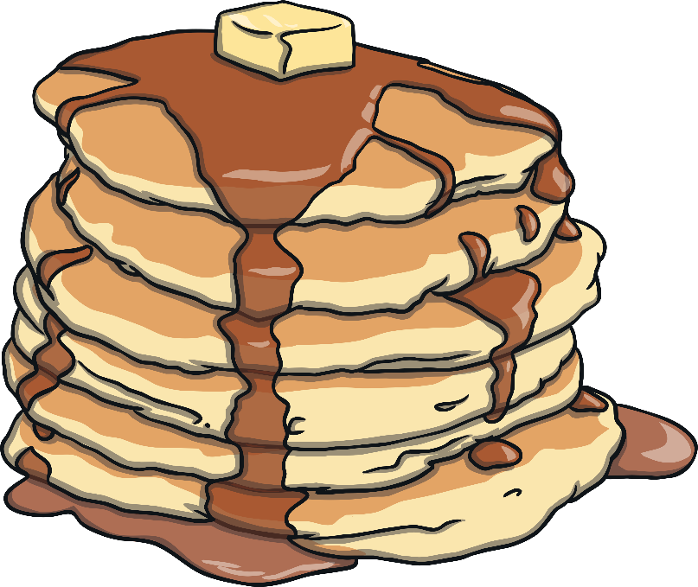
What Day Was It Yesterday?
Yesterday was Pancake Day or Shrove Tuesday.
It is called Shrove Tuesday because we would go to church on that day to be Shriven.
Shriven is an old word and it means that people had to confess all the things that they knew they had done wrong. The priest would bless the people, then they would go home and make pancakes using all the rich and fatty foods ready for...

Slide 3
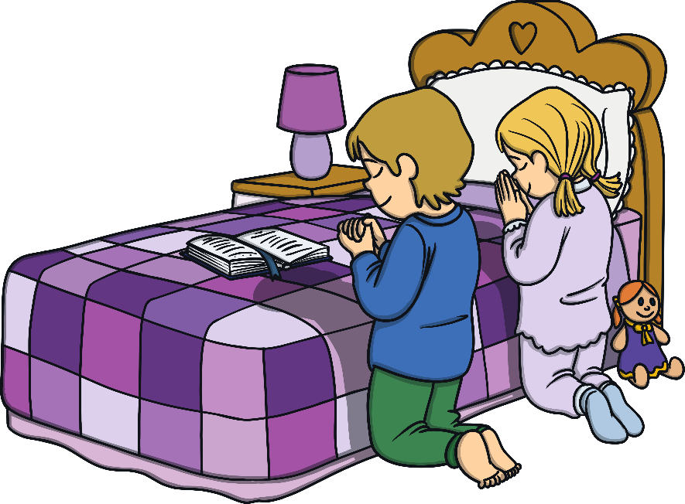
Ash Wednesday
Ash Wednesday is the first day of Lent. Lent is a special time for us, as it is the time before Easter, when we are thinking about how we can improve our behaviour.
We also think about the things Jesus did for us.
During Lent, we often ‘give up’ things. We do this to remind ourselves of the time that Jesus spent in the desert. We give up luxuries and try to resist temptation, to practise self-discipline.
We also do extra things
We also make time to pray more and to attend church often.

Slide 4
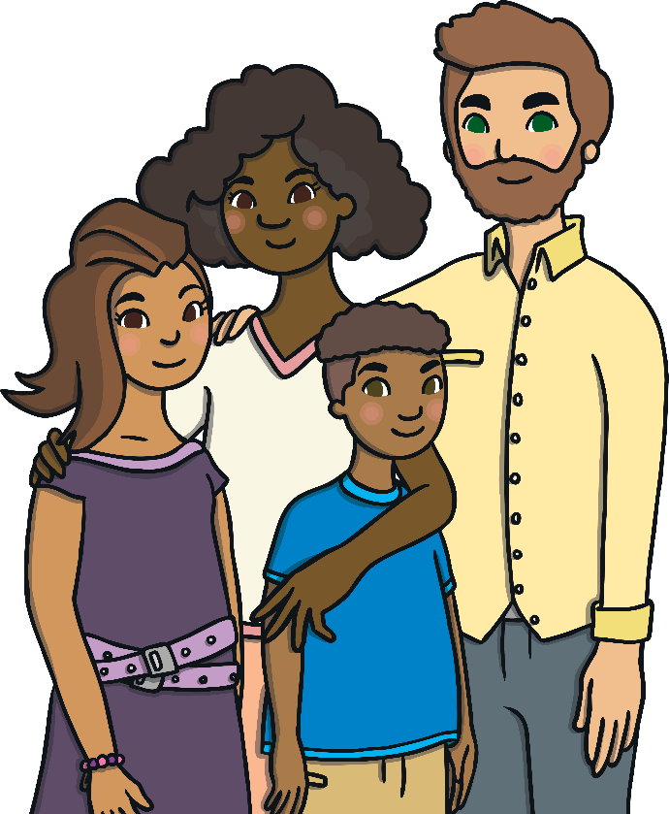
Why is it Called Ash Wednesday?
Ashes are what is left when we burn something.
On Ash Wednesday, we go to a special service to repent. This means we go to church to admit the things we have done wrong and to ask God for forgiveness. During the special service, a special cross is drawn on their head using ashes.
We believe that the ashes are a symbol of being sorry for things we have done wrong. We also believe that having a cross drawn on our head with ash, shows their commitment to God and Jesus Christ.

Slide 5
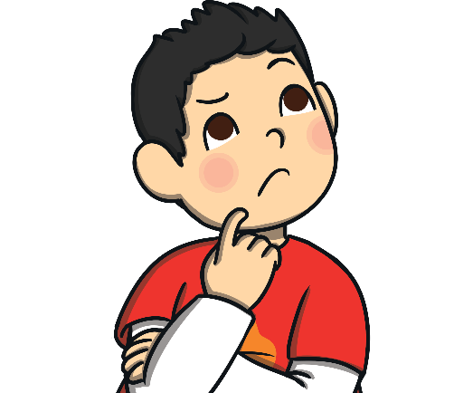
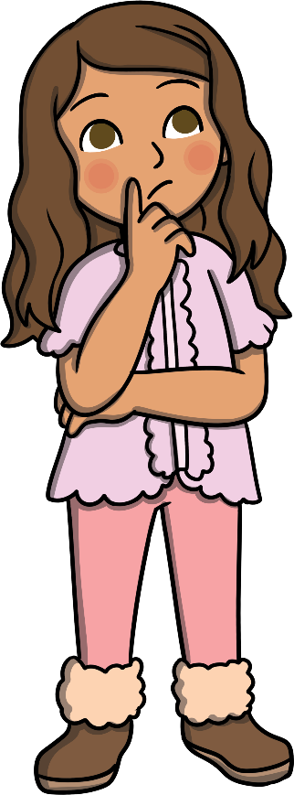
What behaviour would you like to change in yourself?
We think about the things we have done wrong so that they can try to be better people in the future.

