Slide 1
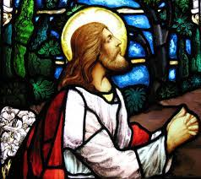
Jesus prayed for his disciples

Slide 2
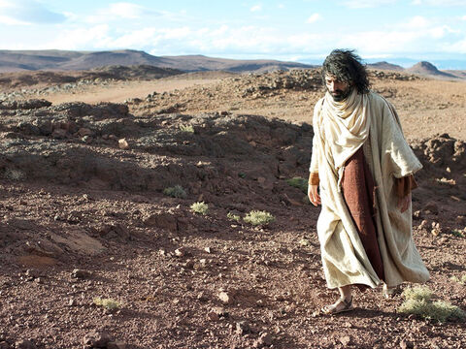
Good Morning
Today we hear how Jesus prayed for his disciples – asking God to protect them and to help them to follow his word. Let us think a bit more about this means for us today.

Slide 3
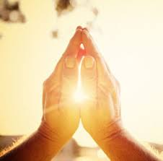
Opening Prayer
Loving God, watch over us, keep us from harm and help us to follow your word and go out into the world to share it with others through our actions. Amen.

Slide 4
The Gospel
In today’s Gospel we will hear the words of Jesus before he leaves Earth to go to heaven.
As I read think about this:
I wonder why Jesus is saying these things
I wonder how Jesus is feeling
Listen out for these words: And for their sake I dedicate myself to you, in order that they, too, may be truly dedicated to you
I wonder what Jesus means by this

Slide 5
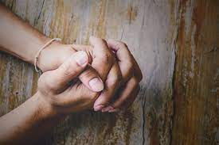
John 17:11-19
And now I am coming to you; I am no longer in the world, but they are in the world. Holy Father! Keep them safe by the power of your name, the name you gave me, so that they may be one just as you and I are one. While I was with them, I kept them safe by the power of your name, the name you gave me. I protected them, and not one of them was lost, except the man who was bound to be lost—so that the scripture might come true. And now I am coming to you, and I say these things in the world so that they might have my joy in their hearts in all its fullness. I gave them your message, and the world hated them, because they do not belong to the world, just as I do not belong to the world. I do not ask you to take them out of the world, but I do ask you to keep them safe from the Evil One. Just as I do not belong to the world, they do not belong to the world. Dedicate them to yourself by means of the truth; your word is truth. I sent them into the world, just as you sent me into the world. And for their sake I dedicate myself to you, in order that they, too, may be truly dedicated to you.

Slide 6
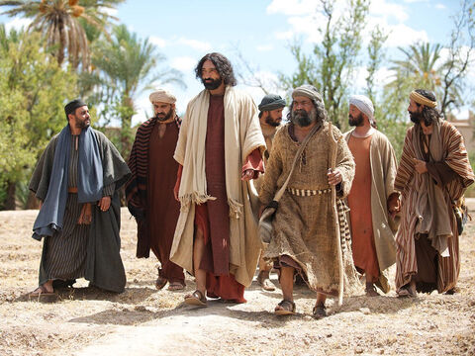
Reflections
Jesus is asking God to help his friends – the disciples – when he is gone.
Jesus knows that it will be hard for them to be without him. But he has also given his disciples a very special job to do and he wants them to carry on doing this, even after he has gone away. So he wants God to keep them safe.
I wonder what job do you think Jesus wants his disciples to do?
Jesus wants his disciples to follow his teaching, to love everyone just like Jesus loves us, and to encourage others to do the same.

Slide 7
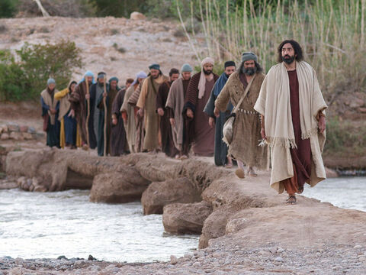
I wonder if Jesus has a special job for us to do as his followers. I wonder what it would be.
He wants us to share God’s love with others – near or far away – and care for the lovely world he has given us.
I wonder how we can do that.
We can share God’s love by helping each other. This also means taking care of our world so that everyone has the chance of a happy life. For example, when we humans cut down forests, that is bad for all the people, animals and plants who live there.

Slide 8
Prayers
We know that it is not always easy to follow Jesus, and so we pray…
We pray for world leaders: that they may be inspired by Jesus and make the right decisions for the good of all people, even when it is hard. Lord, in your mercy…
We pray for the Church throughout the world: that it may be a shining light in the darkest times, bringing help and comfort to all those in need. Lord, in your mercy…
We pray for our friends, family and parish: that we may always follow Jesus, respecting and caring for all people and for our planet. Lord, in your mercy…
Prayers from Year 3

Slide 9
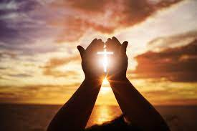
Closing Prayer
Loving God, move us to follow your Son, to share your love with others as we try to help anyone who needs it, and work together to protect our beautiful world. We ask this through Christ our Lord, Amen.

Slide 10
Reflective task
Share with your friends in your class
What is your special job for God?
What can you do to make sure you complete your special job?
Maybe you could draw a picture, write a poem or a prayer all about your special job.
Year 2 prayers next week!

