Slide 2
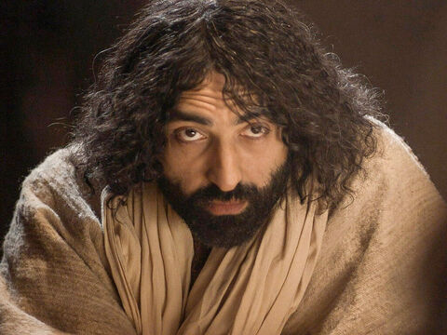
Today we hear how Jesus was teaching with great wisdom, but the people found it hard to believe in him. Let’s listen and find out why.

Slide 3
Opening prayer
God in all things, help us to recognise your Son Jesus in all people – those we know well and those who we will never meet but who are part of our global family. Amen.

Slide 4
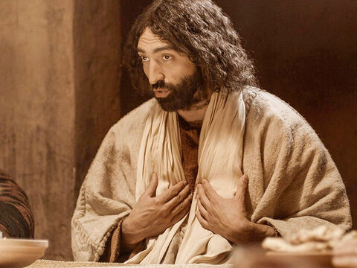
Mark 6:1-6
Jesus left that place and went back to his home town, followed by his disciples. On the Sabbath he began to teach in the synagogue. Many people were there; and when they heard him, they were all amazed. “Where did he get all this?” they asked. “What wisdom is this that has been given him? How does he perform miracles? Isn’t he the carpenter, the son of Mary, and the brother of James, Joseph, Judas and Simon? Aren’t his sisters living here?” And so they rejected him.
Jesus said to them, “Prophets are respected everywhere except in their own home town and by their relatives and their family.”
He was not able to perform any miracles there, except that he placed his hands on a few sick people and healed them. He was greatly surprised, because the people did not have faith.
Then Jesus went to the villages around there, teaching the people.

Slide 5
Reflection
Jesus was back in his home town and teaching in the synagogue. How did the people feel when they heard him speaking?
They were very surprised. They couldn’t understand how Jesus, who they had known since he was a little boy, could have so much wisdom and teach so well.
Why do you think the people were so surprised?
They thought that they knew who Jesus was – the son of Mary and of Joseph the carpenter. They thought Jesus was just an ordinary man, but he wasn’t. Who do we know Jesus to be?
Jesus is the Son of God. But the people he had grown up with could not accept that Jesus was special. They did not believe in him.
Sometimes when we know someone really well we can forget how special they are. It can be hard to see past all the things we know about them, to what they are really like. And sometimes we forget how special the things that we do are, because they just feel ordinary to us.

Slide 6
For example, if your dad always finds time to help out at the local food bank, that’s special, but you might just think it’s ordinary because he has always done it.
Or if your aunt is the best runner in the country and competes in the Olympics, that’s really special too, but you might just not think much about it because that’s normal for your aunt and for you.
Can you think of something special that someone you know does – it could be a friend or a family member or someone else?
And can you think of one thing that you do, that others might see as special?
The people listening to Jesus in today’s reading judge him because of who he is and where he comes from. They are not willing to listen to him or to change their minds, even though he shows wisdom in his teaching. Do you think this is right? Why not?
Have you ever made your mind up about someone just because of where they came from? Or has it happened to you – that people have judged you because of who your family are or where you come from?

Slide 7
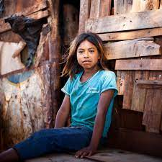
Andreia is 12 and lives in a shanty town in Brazil. Violence and gangs are an everyday problem there.
Andreia used to stay at home for her own safety but without other children to play with she was bored and frustrated.
She has now joined a football team and has lots of friends to play with. As well as being lots of fun, this project has taught Andreia and the other children about their rights and how to live in harmony in their home town.
Perhaps if children can play together peacefully, then when they are grown up they can work together peacefully as adults too.
We are all part of one global family and we are all special. Maybe this week we can try to see how special the people around us are. Our friends and family – who do lots of special things, even though we sometimes don’t notice.
And this week, let’s try not to judge anyone for where they come from or who their family is, but instead listen to them, look out for the special things that they do, and see what we can learn from them.

Slide 8
Let us pray…
We pray together as members of one global family:
We pray for world leaders: that they may work to bring peace to the world. Lord, in your mercy…
We pray for all people who face difficulties because of who they are or where they come from: that they may find strength in knowing that they are loved by God and find comfort in the support of others. Lord, in your mercy…
We pray for our parish, family and friends: that we may see how special all people are, and know we are all members of the same worldwide family. Lord, in your mercy…
Creator God, you made us all in your image and we are all special and loved by you. Help us to treat all people with fairness and respect. Amen

Slide 9
Reflection Task
I wonder if you could write or draw something that is is special about someone you know well, or what special things this person does for you, or for others.

