Slide 1
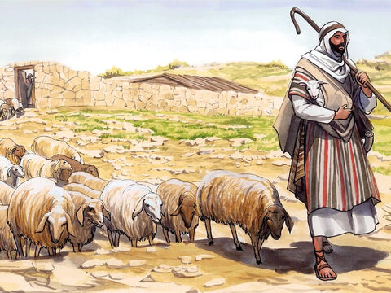
The Good Shepherd

Slide 2
Let’s Worship Together
Today we are going to hear Jesus tell a story.
He calls himself the good shepherd, who cares for his sheep.
This story shows us that Jesus knows and cares for all people.
Let’s think about how we can care for all people too, no matter where they are in the world.

Slide 3
Opening Prayer
Loving God, you know us and care for us.
Help us to remember that all people are loved by you no matter who they are, and to care for others in the world as you do.
Amen.

Slide 4
Praise the Lord
All you nations, praise the Lord. All you people, praise him. The Lord loves us very much. His truth is everlasting.

Slide 5
Gospel
As I read listen out for these words:
“I am the good shepherd. As the Father knows me and I know the Father, in the same way I know my sheep and they know me. And I am willing to die for them.”
I wonder why Jesus calls Himself a good shepherd.
I wonder who He is calling His Sheep.

Slide 6
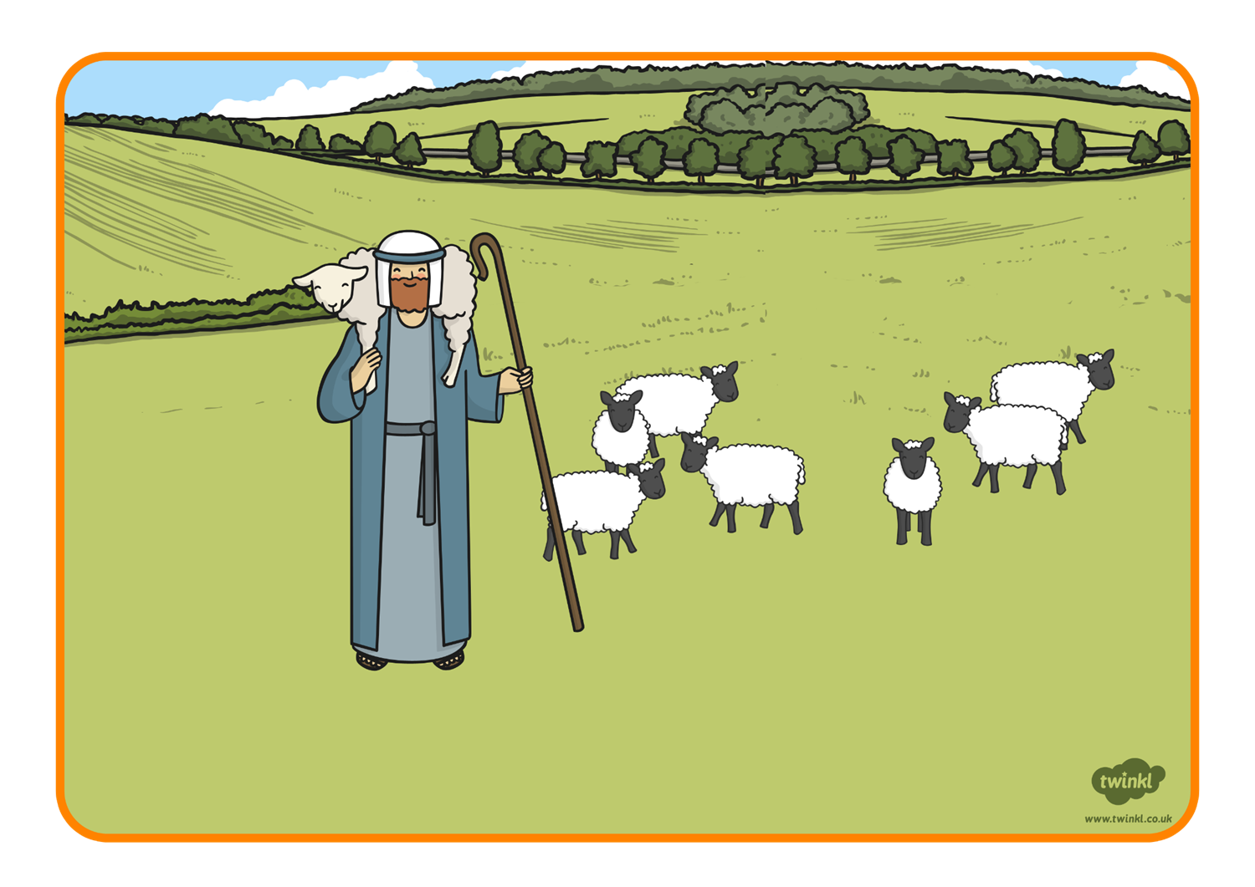
John 10:11-18
“I am the good shepherd, who is willing to die for the sheep. When the hired man, who is not a shepherd and does not own the sheep, sees a wolf coming, he leaves the sheep and runs away; so the wolf snatches the sheep and scatters them. The hired man runs away because he is only a hired man and does not care about the sheep. I am the good shepherd. As the Father knows me and I know the Father, in the same way I know my sheep and they know me. And I am willing to die for them. There are other sheep which belong to me that are not in this sheep pen. I must bring them, too; they will listen to my voice, and they will become one flock with one shepherd.
“The Father loves me because I am willing to give up my life, in order that I may receive it back again. No one takes my life away from me. I give it up of my own free will. I have the right to give it up, and I have the right to take it back. This is what my Father has commanded me to do.”

Slide 7
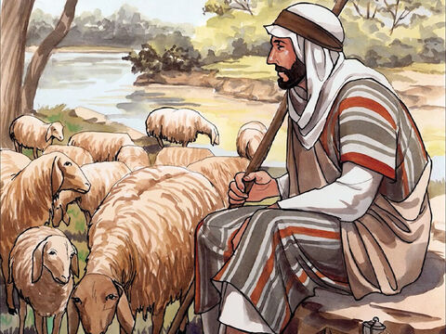
Reflection
Jesus calls himself the good shepherd, who carefully looks after his sheep. I wonder why Jesus calls himself a shepherd.
I wonder who the sheep are that Jesus talks about in this story.
When he says sheep, Jesus means us, because he cares for us and for all people around the world.
I wonder how this makes you feel to know that Jesus loves and cares for you that much.
If a wolf came to attack the sheep in a field, someone who did not care about them would run away, and the sheep would scatter. But Jesus loves his sheep so much he is prepared to die to save them from danger!

Slide 8
Prayers
We know that Jesus is our shepherd who cares for us and listens to us, and so we pray together:
We pray for world leaders: that they may follow Jesus’ example and love and care for their people. Lord, hear us…
We pray for all members of our global family: that we may see that God loves us all equally and treat each other as we would wish to be treated. Lord, hear us…
Year 5 prayers

Slide 9
Reflective Task
I wonder with your class if you can create a flock of sheep and reflect upon Jesus being our shepherd.
Please don’t forget to write your prayers. Next Week Year 4 can read out theirs

