Slide 2
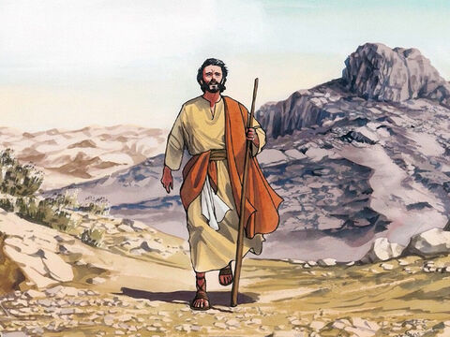
We begin our worship with a reminder that Jesus died and rose again for us and so we gather in the name of the Father, and of the Son, and of the Holy Spirit. Amen
Lent is a time when we pray, do kind things for other people, give up things and give to others, as we prepare to celebrate the great feast of Easter.
For forty days, we accompany Jesus on his journey to Calvary and we see the mercy he shows towards others, despite his suffering. Just as God shows mercy towards us, like Jesus, we try to show mercy to others.
What does Mercy mean?
This Lent, we are also making our journey alongside
families around the world living in poverty, especially
those who do not have the basic things they need like
enough nutritious food to eat.

Slide 3
Opening Prayer
In the name of the Father…
Loving and compassionate God,
teach us to show love and mercy to each other.
As we begin our journey through Lent, inspire us to be generous and kind.
Through our joy, patience and kindness, may we help to build a better world.
Amen.

Slide 4
As the Deer Pants
As the deer pants for the water,
so my soul longs after You.
You alone are my heart's desire
and I long to worship You.
You alone are my strength, my shield,
to You alone may my spirit yield.
You alone are my heart's desire
and I long to worship You.
I want You more than gold or silver,
only You can satisfy.
You alone are the real joy-giver
and the apple of my eye.
You alone are my strength, my shield…
You're my Friend and You're my Brother,
even though You are a king.
I love You more than any other,
so much more than anything.
You alone are my strength, my shield…

Slide 5
Listen out for these words:
“Let your hearts be broken, not your garments torn.”
I wonder what this means

Slide 6
Scripture Reading
A reading from the prophet, Joel (2:12-13)
‘Now, now – it is the Lord who speaks – come back to me with all your heart, fasting, weeping, mourning.’ Let your hearts be broken, not your garments torn. Turn to the Lord your God again, for he is all tenderness and compassion, slow to anger, rich in graciousness, and ready to relent.

Slide 7
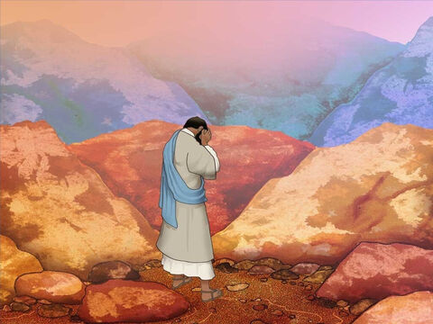
Reflection
Let your hearts be broken, not your garments torn.
In other words, let your heart be opened; it’s not about how you look on the outside, it’s all about what your heart is doing inside. God is full of love and wants us to have hearts filled with love because we have experienced his mercy.
God is forgiving,
God loves us,
God is not angry

Slide 8
What can we do that’s extra this Lent to fill our hearts…
https://www.youtube.com/watch?v=y_a6cJeLH1Y
The Food Bank Collection
Helping Others
Caring for others

Slide 9
Gifts of Love https://www.youtube.com/watch?v=wFB5jbRE2RM https://www.youtube.com/watch?v=9n1ChS-5Unc
Thus you spoke from on high:
Choose to love or to die,
Love to give or deny –
Life and love now blending;
Love is life unending.
Gifts of love, love, love…
Then you came on the earth,
Gift of love from your birth;
Shared our life, gave us worth;
To yourself inviting,
God with us uniting.
Gifts of love, love, love…
Gift of love, dawning bright,
Pierces through endless night:
God of life, sharing might,
All creation holding,
Earth and sky unfolding.
Gifts of love, love, love.
Gifts of love, love, love.
Glory be, Lord to thee,
God of our salvation.

Slide 10
Let’s Pray
The response is: Hear our prayer.
Loving God, we pray for our school family as we begin this season of Lent. Help us to be generous in our actions.
Lord, in your mercy: Hear our prayer.
Caring God, we pray for families who do not have the basic things in life like enough food to eat. Through our fundraising, help us to support more families to free themselves from poverty.
Lord, in your mercy: Hear our prayer.
Wonderful God, we pray for one another as we journey through Lent. As we pray, give things up, and think of others, inspire us to be kind and show mercy in our actions.
Lord, in your mercy: Hear our prayer.

Slide 11
Loving God,
We thank and praise you
for all the gifts you have given us.
But in a world of plenty
too many people go hungry.
We pray that you may work through us,
so our small acts of love
may make a big difference
and everyone may have enough to eat.
Amen
In the name of the Father, and of the Son, and of the Holy Spirit.

