Slide 2
Opening Prayer
In the name of the Father…
Loving and compassionate God,
teach us to show love and mercy to each other.
As we begin our journey through Lent, inspire us to be generous and kind.
Through our joy, patience and kindness, may we help to build a better world.
Amen.

Slide 3
What is Lent?
Lent is a period of time that leads up to Easter.
It begins on Ash Wednesday (which is the day after Pancake Day.)
It is a very important time for us.
Lent lasts for 40 days (not including Sundays).

Slide 4
Why is Lent 40 Days Long?
Lent is 40 days long because this is how long Jesus spent in the desert to be with God.
During this time he had no food and nothing to drink. He was also tempted by the Devil. We use Lent as a time to think about Jesus.

Slide 5
What Do We Do During Lent?
In the past, Christians would give up all ‘rich’ food and drink during Lent. This meant food such as meat, eggs, fats and milk products weren’t eaten.
People used up their ‘rich’ foods before Lent began by making pancakes. This is why we have Pancake Day.

Slide 6
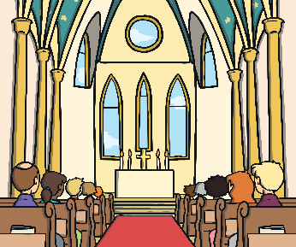
What Do We Do During Lent?
During Lent, many Christians try to ‘give up’ or ‘stop having’ something they like. It might be chocolate or something like video games.
They do this to remember Jesus’ struggles in the desert, when he didn’t have food or drink and also to see if they can resist being tempted, like Jesus did in the desert.
Lots of churches also hold special Lent services.

Slide 7
When Does Lent Finish?
Lent ends at Easter, when we remember
when Jesus died on the cross and came back to life.

Slide 8
What is your promise?
Lent is a time for us to remember Jesus’ struggles in the desert and how he didn’t give in to temptation.
At St Martha’s we are going to think of extra things we
can do to help people. (friends family and community –
Food bank)

Slide 9
Let’s Pray
The response is: Hear our prayer.
Loving God, we pray for our school family as we begin this season of Lent. Help us to be generous in our actions.
Lord, in your mercy: Hear our prayer.
Caring God, we pray for families who do not have the basic things in life like enough food to eat. Through our fundraising, help us to support more families to free themselves from poverty.
Lord, in your mercy: Hear our prayer.
Wonderful God, we pray for one another as we journey through Lent. As we pray, give things up, and think of others, inspire us to be kind and show mercy in our actions.
Lord, in your mercy: Hear our prayer.

Slide 10
Loving God,
We thank and praise you
for all the gifts you have given us.
But in a world of plenty
too many people go hungry.
We pray that you may work through us,
so our small acts of love
may make a big difference
and everyone may have enough to eat.
Amen
In the name of the Father, and of the Son, and of the Holy Spirit.

