Slide 1
Baptism of the Lord

Slide 2
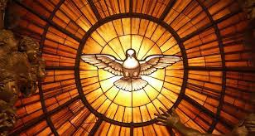
Today we hear about Jesus’ Baptism and about something very special that happened after it. He was filled with the Holy Spirit. Let’s think some more about the Holy Spirit.
In the name of the Father…

Slide 3
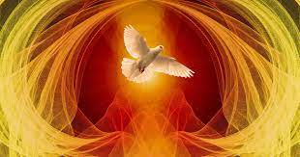
Opening Prayer
God of heaven and earth, you sent your Son Jesus to lead us to you. Send your Holy Spirit into our hearts so that we may have faith and courage to follow Jesus in all that we do. Amen.

Slide 4
In today’s reading
We hear about how John the Baptist was baptising people with water.
He says that someone is coming who is more powerful than he is. I wonder who that person is.
Listen out for John saying he is not good enough to untie the strap of Jesus’ sandals. I wonder what John meant by this.

Slide 5
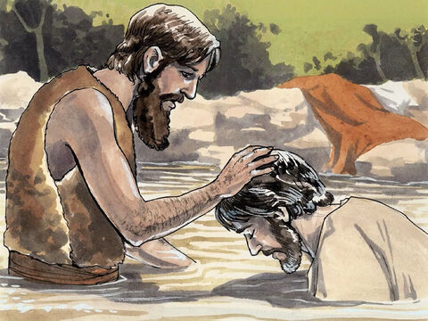
The Gospel according to Luke
People's hopes began to rise, and they began to wonder whether John perhaps might be the Messiah. So John said to all of them, “I baptize you with water, but someone is coming who is much greater than I am. I am not good enough even to untie his sandals. He will baptize you with the Holy Spirit and fire.
After all the people had been baptized, Jesus also was baptized. While he was praying, heaven was opened, and the Holy Spirit came down upon him in bodily form like a dove. And a voice came from heaven, “You are my own dear Son. I am pleased with you.”
The Gospel of the Lord…

Slide 6
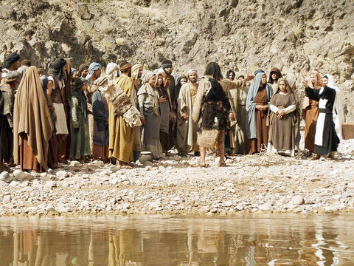
Did you hear in the reading that John does not feel that he is important enough to help Jesus. But, Jesus asks to be baptised by John. I wonder what this shows us about Jesus.
All of us are important in our own special way, and we are all important enough to serve Jesus. Jesus welcomes us all and sees that we all have special gifts and talents to share.

Slide 7
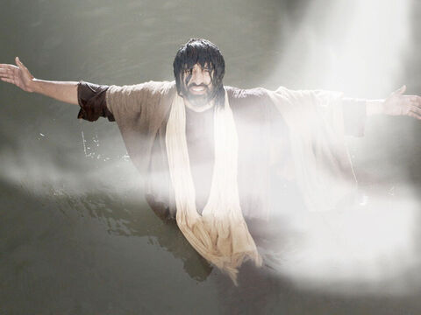
Jesus prays, and while he is praying, the Holy Spirit comes down like a dove. Then a voice comes from heaven. I wonder who this could be.
It’s God he says, “You are my Son and I am pleased with you”
Jesus is the Son of God and he is filled with the Holy Spirit. We are all God’s children and we are also filled with the Holy Spirit at our baptism.
I wonder what difference you think it makes being filled with the Holy Spirit.
The Holy Spirit can help to make us brave and to bring us joy. Just as we can tell that a tree is good because of the fruit that grows on it, we can tell if the Holy Spirit is working in us by the way that we act and how we treat other people.

Slide 8
For instance, we can share what we have with others who do not have enough. We can be kind to others. We can try to make our world a fairer and better place for all people to live in.
Some fruits of the Spirit are love, peace, kindness and generosity.
I wonder how you think you can be kind, loving and generous to others. I wonder how you can bring peace.
We are all God’s children no matter where in the world we live, no matter where we come from or what we look like, whether we are rich or poor. We are all members of the same global family. And so we try to be loving, kind, generous and bring peace to all people. In this way, we hope that others will be able to see the fruits of the Holy Spirit and our baptism in all that we do.
I wonder how you will show the Holy Spirit working in you in this coming week..
Take a moment to reflect on this.

Slide 9
We are all children of God and so we pray together:
We pray for all leaders in the world: that they may listen to their people, rule fairly and do all that they can to bring peace to our world.
Lord, in your mercy…
We pray for all members of our global family: that we may all know peace, love, joy and generosity in our lives.
Lord, in your mercy…
We pray for our parish, families and friends: that we may be filled with the Holy Spirit, serve others who are in need and share love as Jesus taught us.
Lord, in your mercy…
God of love, as we gather at your table, we give thanks for your love. Fill us with your Holy Spirit and help us to show your love to others in all that we do. Amen.

