Slide 1
Jesus changed water into wine

Slide 2
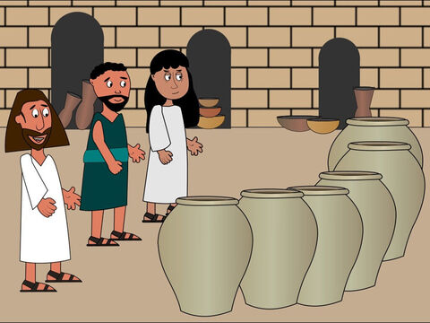
In today’s gospel we hear how Jesus did something very special at a wedding in Cana, changing water into wine. Let’s think about the changes we can make in our lives and in our world.
In the name of the Father…
God of wonder, we know all things are possible for you. Help us to work together to change the world, so that it becomes a fairer place for all to live. Amen.

Slide 3
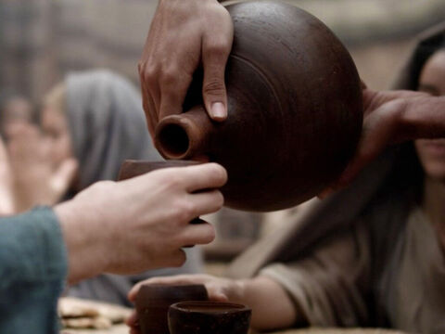
John 2:1-11
Two days later there was a wedding in the town of Cana in Galilee. Jesus' mother was there, and Jesus and his disciples had also been invited to the wedding. When the wine had given out, Jesus' mother said to him, “They have no wine left.”
“You must not tell me what to do,” Jesus replied. “My time has not yet come.”
Jesus' mother then told the servants, “Do whatever he tells you.”

Slide 4
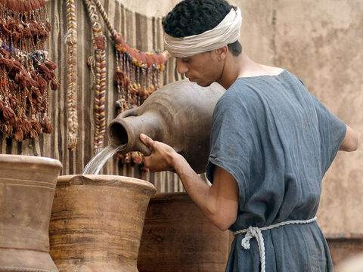
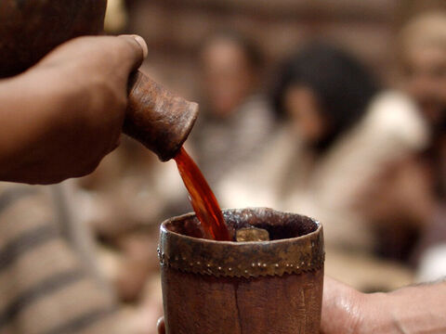
The Jews have rules about ritual washing, and for this purpose six stone water jars were there, each one large enough to hold about a hundred litres. Jesus said to the servants, “Fill these jars with water.” They filled them to the brim, and then he told them, “Now draw some water out and take it to the man in charge of the feast.” They took him the water, which now had turned into wine, and he tasted it. He did not know where this wine had come from (but, of course, the servants who had drawn out the water knew); so he called the bridegroom and said to him, “Everyone else serves the best wine first, and after the guests have had plenty to drink, he serves the ordinary wine. But you have kept the best wine until now!”
Jesus performed this first miracle in Cana in Galilee; there he revealed his glory, and his disciples believed in him.

Slide 5
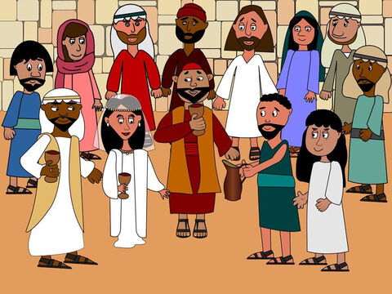
Let’s reflect
Jesus, his mother Mary, and the disciples were at a wedding, where they ran out of wine. Mary asked Jesus to help and so he changed some water into wine so that the celebration could continue.
I wonder how the servants must have felt when they saw that the water had turned into wine. It must have been very surprising for them. And for the bride and bridegroom who were told that they had saved the best wine for last.
Let’s think what the word, “miracle” means. It is when we don’t know how something happens, and we know it can only have been done by God, we call it a miracle.
Turning the water into wine is the first miracle that Jesus performs.

Slide 6
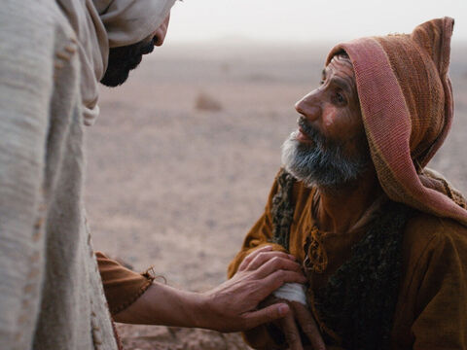
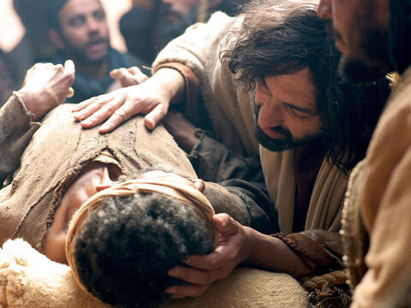
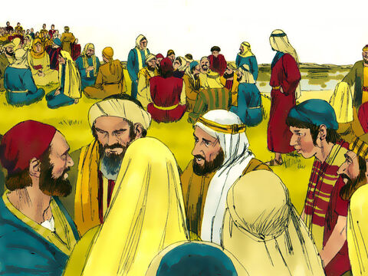
Can you think of any others? (feeding the 5,000, healing people etc)

Slide 7
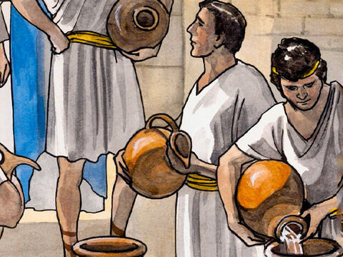
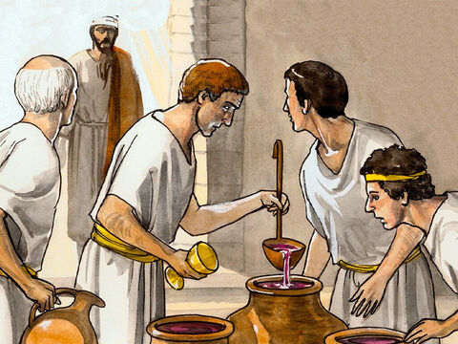
I wonder why he performed this miracle, turning the water into wine.
I wonder what it tells us about him. The miracle shows us how special and important Jesus is. It shows us that he is the Son of God and that he can do anything. While we cannot work miracles, we can make real changes that make a difference to our own lives and the lives of others.

Slide 8
Later today I am going to be finding out about a group called Mini Vinnies in hope that we can set up a group of children at St Martha’s. Mini Vinnies get together and work out projects that we can do to help the people in our community.
But in the meantime, I wonder what you can do to help people in your daily lives?
Take some time to reflect on this now.
Through seeing Jesus’ miracle the disciples believed in him. Through our actions we hope that others will see that we believe in Jesus too.

Slide 9
We pray that we will find ways to help each other out this week. Lord, in your mercy…
We pray that we will find ways to ensure we have always got kind hands, kind feet and kind words this week. Lord, in your mercy…
We pray for our parish, families and friends: that we may be inspired to make a difference, to support each other and have a lovely week in school. Lord, in your mercy…
God of life, may we be inspired by the miracles that your Son Jesus performed, to do our best to make a real difference to others by helping those around us. Amen.
In the name of the Father…

